Slide 1


Community Kit for SharePoint
Development Tools Edition
Wesley Hackett
Solutions Architect
Content and Code
Be sure to visit - http://cksdev.codeplex.com
Notes:
Introduce myself
Solutions Architect for Content and Code with development background
Working with SharePoint for over 4 years, WCM, ECM and VS tools
Founding member of CKSDev
Explain what the Community Kit for SharePoint
Previous CKS output has been installable end products like the Enhance SP Blog

Slide 2
Outline
Where have we been?
What’s in the box today?
Overview of CKSDev
Getting productive WCM scenario demo
Where do I get CKSDev?
Project information
Questions
Be sure to visit - http://cksdev.codeplex.com
Notes:
Where have we been?
Quick recap of what was available to us for MOSS dev
What’s in the box today?
Overview of the new VS2010 tools
Overview of CKSDev
Overview of the CKSDev
Getting productive WCM scenario demo
Going to demo some of the tools in a WCM style scenario
Where do I get CKSDev?
Information about how and where to get CKSDev
Project information
Information about the project
Questions
Any questions

Slide 3
Where have we been?
SharePoint 2007 Development Experience
Limited Tooling
VSeWSS 1.3
Community
WSP Builder
STSDev
SPVisualDev
Hand crafting
Intimate knowledge of CAML and XML
Understanding the SP Root structure
Understand how to package with chosen tool
Be sure to visit - http://cksdev.codeplex.com
Notes:
The SharePoint 2007 Experience wasn’t ideal
Lack of true VS support
Visual Studio Extensions for WSS 3.0 was much improved as it evolved from version 1.0 to 1.3 but still wasn’t widely adopted
Many community offerings
Generally this was a personal preference meaning skills between dev’s differed
Not all had F5 debugging which reduced productivity
Hand crafting
Frustrations from hand crafting xml, CAML
Became a specialist skill
Barriers to entry for ASP.Net devs wanting to get into SharePoint

Slide 4
What’s in the box today?
SharePoint 2010 Development Experience
Integrated VS tools
SharePoint Explorer for site exploration
SharePoint project and item templates
Visual designers for key scenarios like packaging
Migration for VSeWSS projects
Benefits
Abstracts away the SharePoint Root details
F5 debugging with configurable deployment
Allows easier control of packaging
Extensible tools API
Be sure to visit - http://cksdev.codeplex.com
Notes:
The Visual Studio 2010 SharePoint Tools provides a end to end development experience
Server explorer allows a dev to interrogate the local site
Project items allow pre-configured projects to be created
Item templates allow quick creation of things like content types
Packaging becomes much easier to configure now that designers are provided
Migration for VSeWSS projects
Benefits
We no longer have to structure VS projects the same as the SharePoint Root dictates
Allows better logical layouts for solution/projects
F5 debugging
Auto attach the debugger
Retract and deploy the solution
Auto recycle the app pool
Configurable
Control of packaging through designer to allow multiple projects to output one wsp etc.
Extensibility API for the tools
This is where we enter the CKSDev story

Slide 5
CKSDev overview
Covers four areas:
Environment
Explorer
Content
Deployment
Integrated into Visual Studio 2010
Two versions
CKSDev for SharePoint Foundation 2010
CKSDev for SharePoint Server 2010
Be sure to visit - http://cksdev.codeplex.com
Notes:
Embraces the VS2010 SharePoint tools extensibility model
Uses supported API
Enhances the OOB but doesn’t replace it
We work with the MS team to ensure we ‘play nice’
CKSDev works with Microsoft’s SharePoint Power Tools and other MS VS extensions
Four Areas:
Environment > Covers extensions directly to the VS IDE
Explorer > Covers extensions to the server explorer
Content > Project and item templates
Deployment > New deployment steps and Quick Deploy
Integrated within Visual Studio, feels like part of the product
Downloaded from Visual Studio Gallery
Versions
Foundation for those using SharePoint Foundation only
Server for those using SharePoint server
Supported through our CodePlex site

Slide 6

Features
Environment
SharePoint references tab
Copy assembly name
Exploration
Common Galleries
Pages
Web templates
Activate/Deactivate features
Dev dashboard settings
Generate entity classes
Open SPD
File IO for editing
Content type grouping
Site columns with grouping
Import content type(s)
Import site column(s)
Generate page layout from content type
Generate page template
Export page
Content
Fluent UI Visual web part
Starter master page
Blank site definition
Custom action group
Custom action
Hide custom action
Delegate control
Full trust proxy
SPMetal definition
SharePoint console application
Deployment
Quick deploy
Auto quick deploy
Recycle App Pools
Attach to worker process
Deployment steps
Be sure to visit - http://cksdev.codeplex.com
Notes:
Environment
SharePoint references tab
Copy assembly name
Exploration
Common Galleries
Pages
Web templates
Activate/Deactivate features
Dev dashboard settings
Generate entity classes
Open SPD
File IO for editing
Content type grouping
Site columns with grouping
Import content type(s)
Import site column(s)
Generate page layout from content type
Generate page template
Export page
Content
Fluent UI Visual web part
Starter master page
Blank site definition
Custom action group
Custom action
Hide custom action
Delegate control
Full trust proxy
SPMetal definition
SharePoint console application
Deployment
Quick deploy
Auto quick deploy
Recycle App Pools
Attach to worker process
Deployment steps

Slide 7
Getting productive with CKSDev
Demo scenario:
Small WCM site
Custom masterpage
Custom content types
Custom page layouts
Page
Team member
Press release
Global banner
Be sure to visit - http://cksdev.codeplex.com
Notes:
Run through the basic scenario
Lets build a small WCM site
Needs content types for the page types
Page
Team member
Press release
Needs custom branding
Master page
Page layouts
Global banner delegate control

Slide 8
Demo
Building a WCM solution scenario
Be sure to visit - http://cksdev.codeplex.com
Notes:
In here needs to go the typed up notes from my pad…… demo in TFS under usual folder

Slide 9
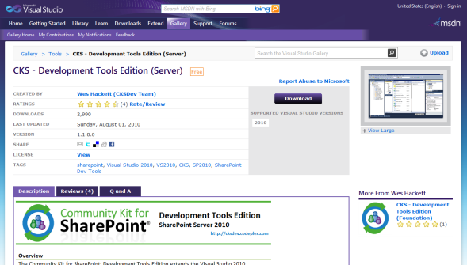
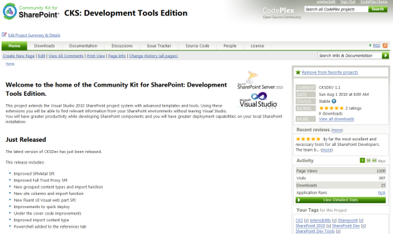
Download Details
Visual Studio Gallery:
SharePoint Foundation 2010
http://visualstudiogallery.msdn.microsoft.com/en-us/a346880f-2d29-47a6-84a2-f2d568dd6997
SharePoint Server 2010
http://visualstudiogallery.msdn.microsoft.com/en-us/ee876627-962c-4c35-a4a6-a4d89bfb61dc
Project site:
http://cksdev.codeplex.com
Be sure to visit - http://cksdev.codeplex.com
Notes:
Visual Studio Gallery is the location
You can find CKS directly from the VS Extension Manager by searching for CKSDev
Updates will be automatically notified of new versions in the gallery
Project site
Information
Feature list
How To’s
Links to demo video’s (coming soon)
Discussions of new features
Defect list > hoping this one stays empty ;)
Team contact details
And of course the Code
NB that no Download! This is because we want you to use VS Gallery so you get updates.

Slide 10



Fancy getting your hands dirty?
Have a great idea?
Submit it as a new ‘Feature’ in the Issue Tracker
Found a bug?
Submit it as a new ‘Issue’ in the Issue Tracker
Include as much info as you can
Have a working extension prototype?
Contact the team to discuss potential inclusion
Be sure to visit - http://cksdev.codeplex.com
Notes:
We’re looking for the community to help us drive CKSDev
The project backlog is in the ‘Issue Tracker’ on our CodePlex site
Vote for your favourite features
If you have an idea then submit details as a new ‘Feature’ in the Issue Tracker
Found a bug?
Submit as much info as you can into a new ‘Issue’ in the Issue Tracker
Prototype
If you have an extension or working prototype then speak to any member of the team to discuss it’s potential inclusion

Slide 11







Project Team
Wouter van Vugt
@woutervugt
http://blogs.code-counsel.net/Wouter/
Matt Smith
@mattsmithnz
http://blog.mattsmith.co.nz/
Waldek Mastykarz
@waldekm
http://blog.mastykarz.nl/
Carsten Keutmann
@keutmann
http://keutmann.blogspot.com/
Wes Hackett
@weshackett
http://weshackett.spaces.live.com/blog/
Jeremy Thake
@jthake
http://www.made4the.net/
Todd Bleeker
@toddbleeker
http://sharepoint.mindsharpblogs.com/Todd/
Be sure to visit - http://cksdev.codeplex.com

Slide 12
Questions?
Thank you for attending.
Be sure to visit - http://cksdev.codeplex.com
Notes:
Thank the attendees
Any questions??

